Slide 1
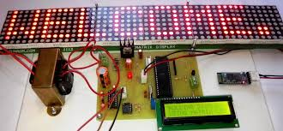
VOICE BASED NOTICE BOARD SYSTEM

Slide 2
GROUP MEMBERS:
1. Jadhav Rutuja sanjay.
2. Walhekar Komal Balaso.
3. Devkar Poonam Dhanaji.
4. Kanse Payal Ashok.
UNDER GUIDANCE OF-
(Prof. Jarad U.T)

Slide 3

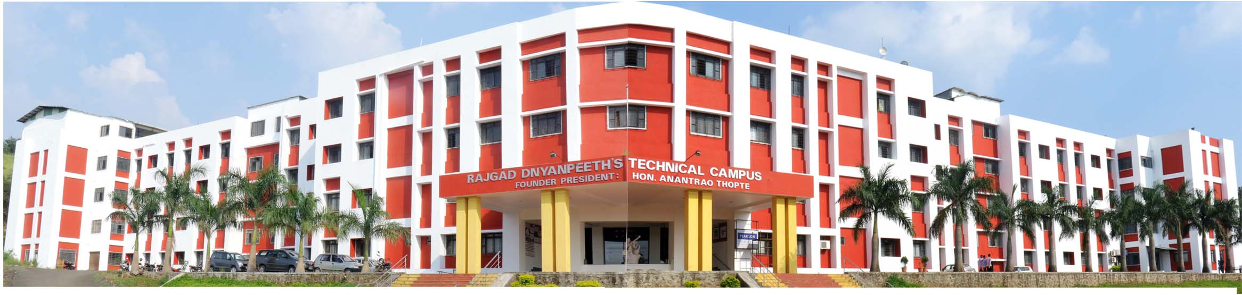
SHRI CHHATRAPATI SAMBHAJIRAJE POLYTECHNIC DHANGWADI,PUNE

Slide 4
CONTENTS:
Introduction
Block diagram
Block diagram description
Bluetooth module
Android
LCD display
Advantages
Disadvantages
Applications
Conclusion
Future scope
References

Slide 5
INTRODUCTION:
Main concept behind voice operated electronic notice board using is to show message and control them by using our own message.
We have already seen GSM primarily based synthesictronic board, but speech controlled board has extra advantages of simple use.
Bluetooth is one of the fastest growing field in wireless technology.

Slide 6
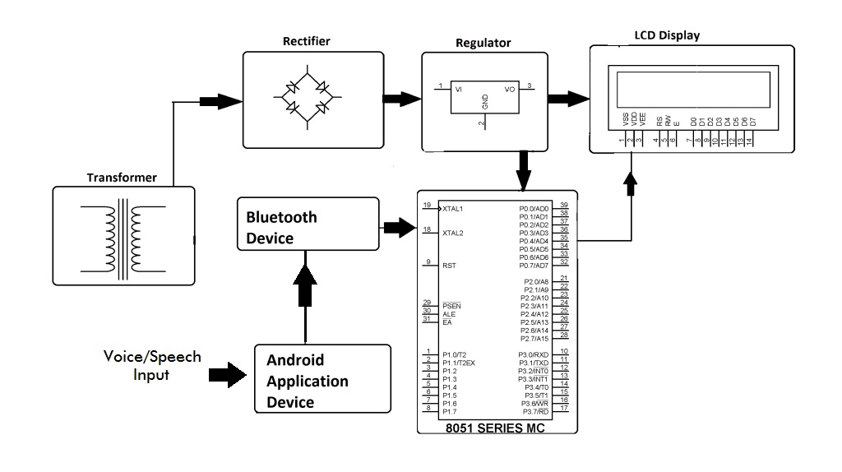
BLOCK DIAGRAM:
Fig: Block diagram of voice based notice board system

Slide 7
BLOCK DIAGRAM DESCRIPTION:
8051 Microcontroller .
Bluetooth module .
LCD display.
Regulator.
Rectifier.
Transformer.
Android application device.

Slide 8
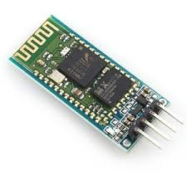
BLUETOOTH MODULE:
Fig: Bluetooth Module

Slide 9
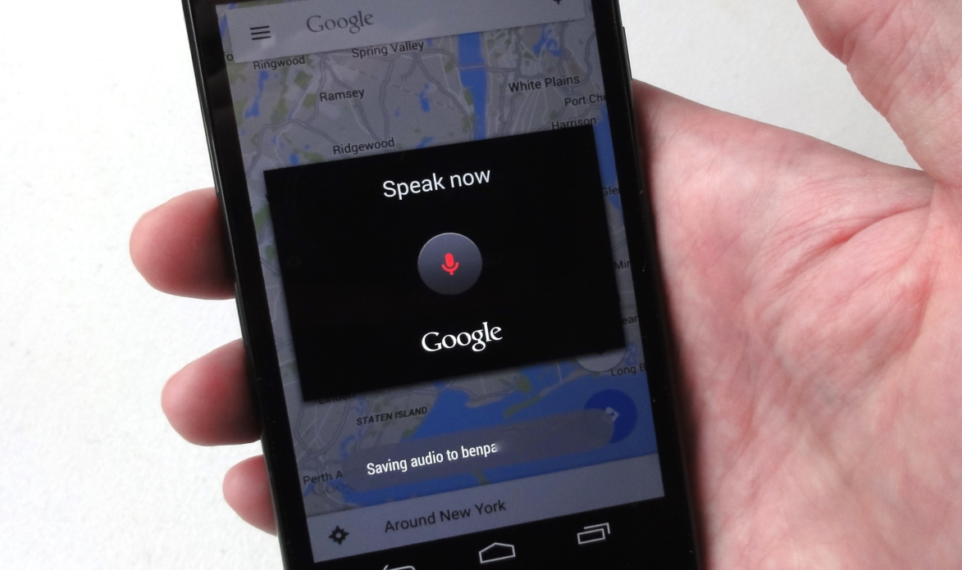
ANDROID:
Fig: Voice search Android

Slide 10
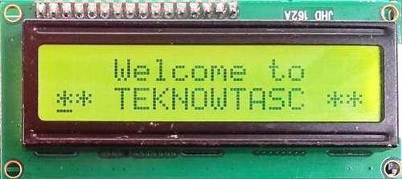
LCD DISPLAY:
Fig: 16x2 LCD display

Slide 11
ADVANTAGES:
Wireless Notice Board is easy to install and easy to use.
Speech controlled rolling display is really helpful for disabled people or handicapped people.
It requires less time.
Gross error does not occurs.

Slide 12
DISADVANTAGES:
It Range is limited to 10 meters.
requires proper pronunciation.

Slide 13
APPLICATIONS:
Advanced wireless notice board can be used in public transportation like Bus station , Railway station and even it airports.
Voice operated electronic notice board find its main educational premises like School , College , University Campuses.
It can be used to display information like Exam schedule , notice , event notification and Exam Result announcement.

Slide 14
CONCLUSION:
By introducing the concept of this technology in the Field of the communication we can make our communication more efficient and faster, with greater efficiency. We can display the messages with less errors and maintenance. This system can be used in college, school, offices, railway station and commercial as well as personal used.

Slide 15
FUTURE SCOPE:
Future work focuses on implementation of Wi-Fi system.
Multilingual display can be another added variation in the system.
The Bluetooth printing has been implemented successfully with android phone and outputs have been verified.

Slide 16
REFERENCES & BIBLOGRAPHY
REFERENCES -
Prof. R. G. Gupta, Nawale Shubhangi, Tupe Usha, Waghmare Priyanka. Android based E-notice board. International Journal of Advance Research and Innovative Ideas in Education (IJARIIE).
Abhishek Gupta, Rani Borkar, Samita Gawas, Sarang Joshi. GSM based wireless notice board. International Journal of Technical Research and Applications.
BIBLOGRAPHY –
www.google.com

Slide 17
THANK YOU

